Slide 1
The relationship between Nesterov’s algorithm(or called FISTA) and ODE
交大電機學系 碩士班 張詔揚
E-mail: Hippo88902.ee11@nycu.edu.tw

Slide 2
What is Nesterov’s algorithm(1983):
An algorithm to minimize a convex function
Accelerated gradient method with optimal O(1/k^2 ) rate.
Faster than vanilla gradient descent methods O(1/k).
It is widely used in many fields.

Slide 3
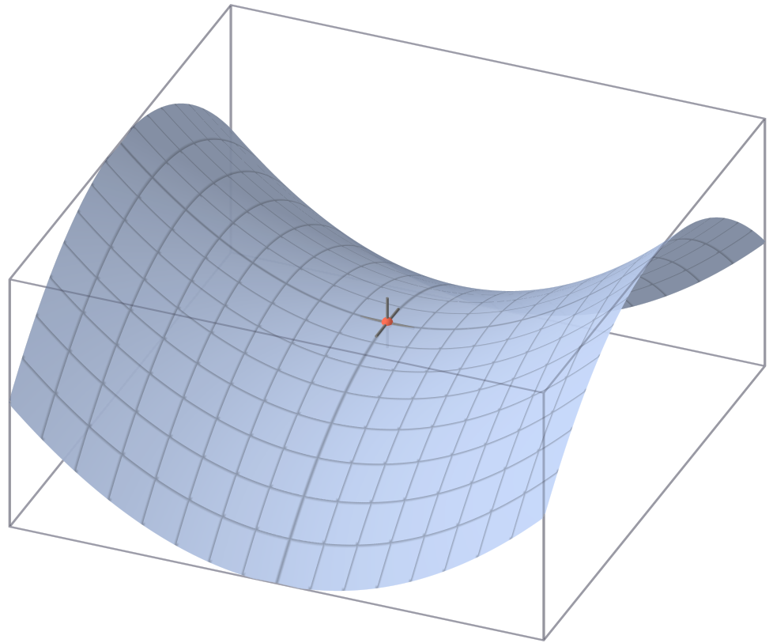
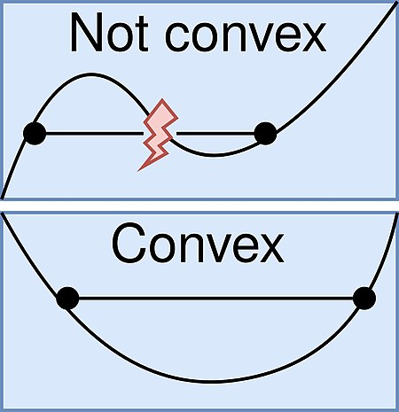
Why convex?
non-convex optimization is at least NP-hard

Slide 4
為什麼要minimize 一個function?
希望我們的方法能夠準確還原實際的狀況
深度學習中的loss function(越小代表我們predict的越準)
Signal/image denoising
Data compression

Slide 5
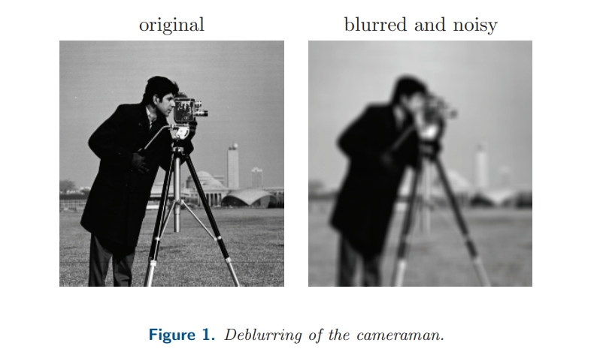
一個小範例:

Slide 6


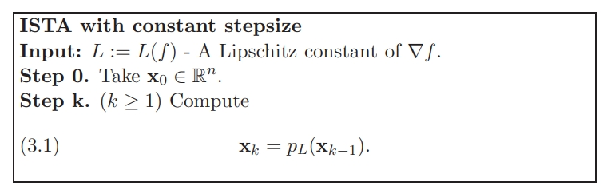
ISTA:

Slide 7
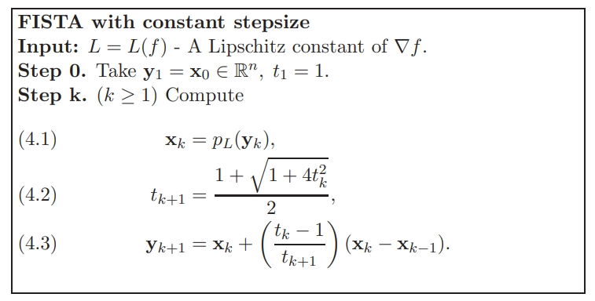
FISTA = Nesterov‘s algorithm

Slide 8
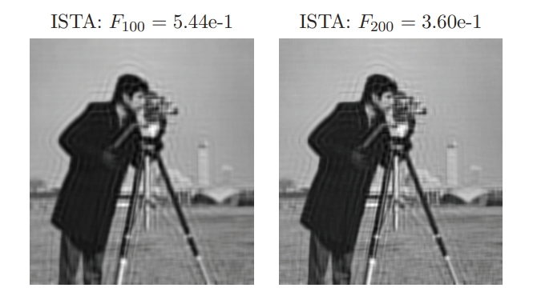
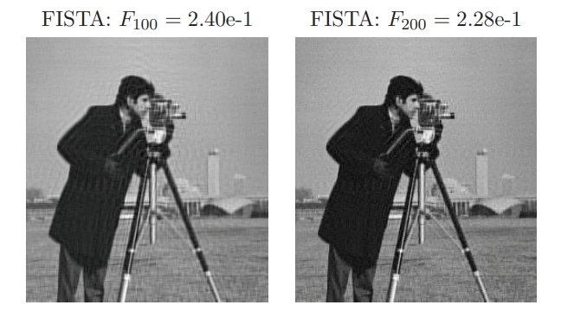

Slide 9
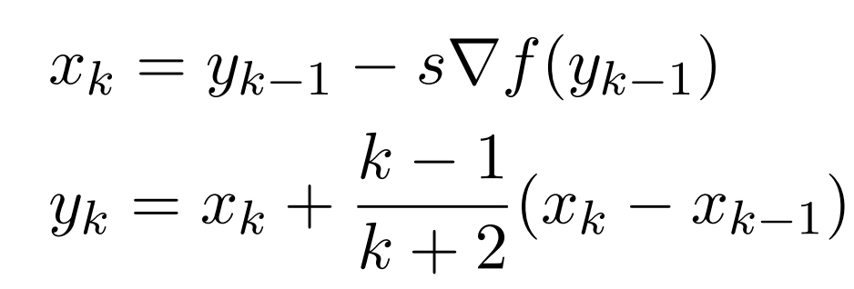
Nesterov‘s scheme:

Slide 10
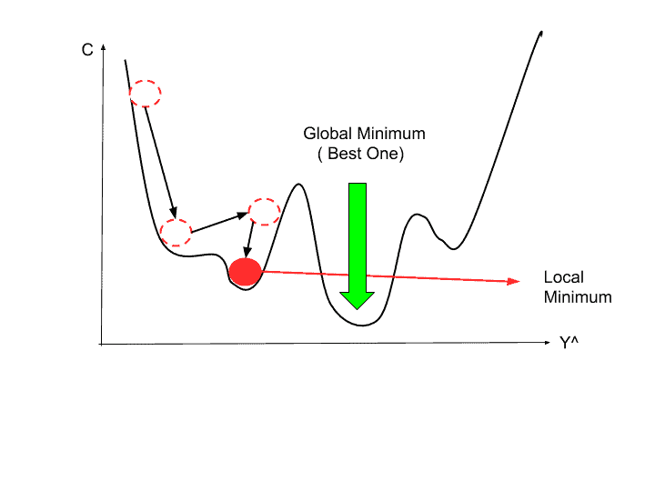
Why it can minimize a function by iteration?
因為我們使用了gradient資訊去找尋minimizer
我們的目標函數是convex

Slide 11
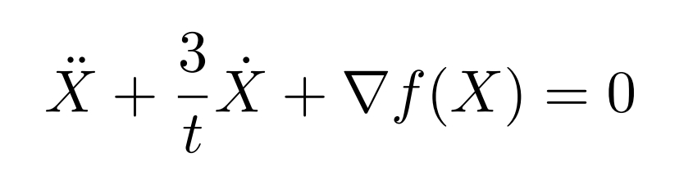
When step size is small:

Slide 12
Oscillating
When t is small, 3/t is large. This leads the ODE to approach to the equilibrium without oscillating.
When t is large, 3/t is small. This leads the ODE to oscillate around the equilibrium.
利用一個簡單的程式來呈現Nesterov‘s algorithm的震盪行為
延伸: FISTA algorithm …

Slide 13
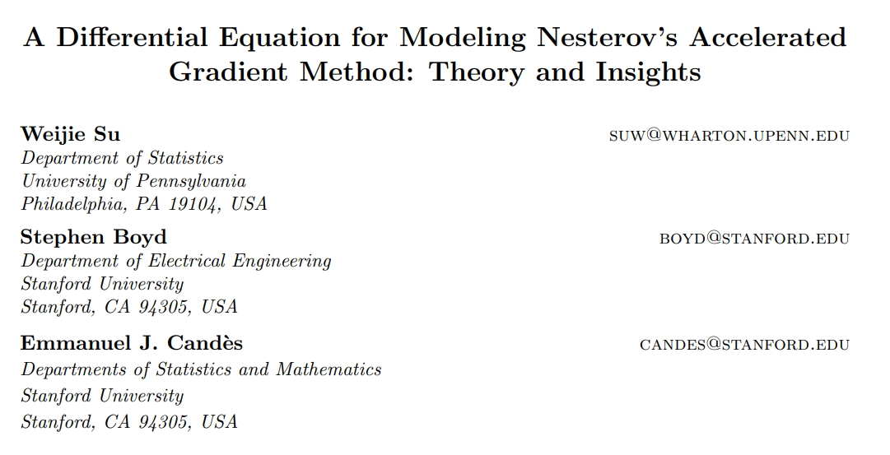

Slide 14
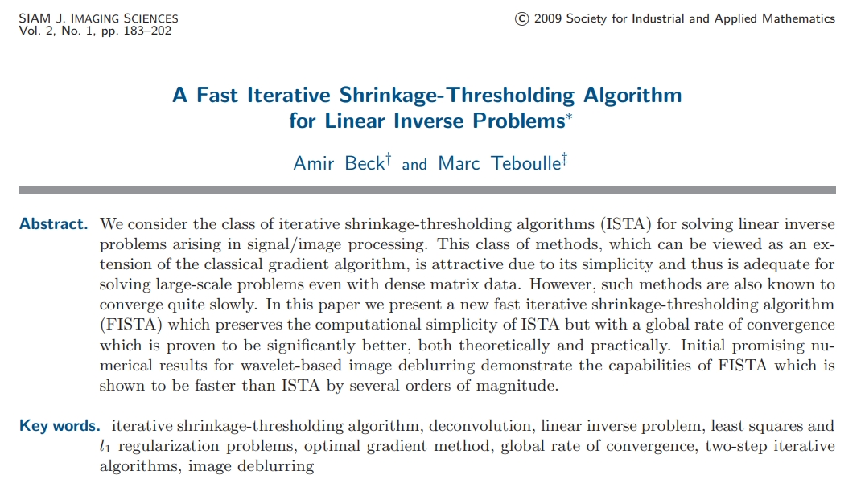
Citation: 11676 次

